Slide 1

CHECKID
PRODUCT OVERVIEW
Verify the RFID chip with NFC

Slide 2






CONTENTS
Introduction
Features & Benefits
Solution Proposal
Why Check ID?
Demo

Slide 3
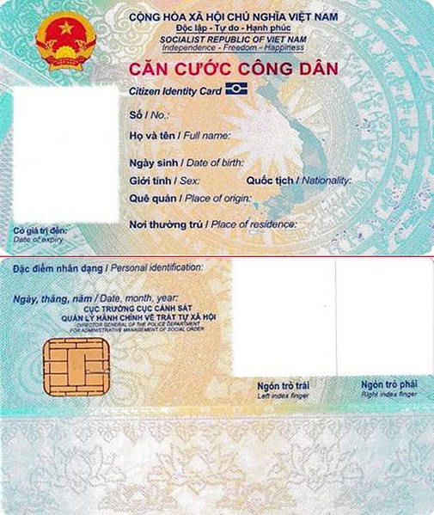
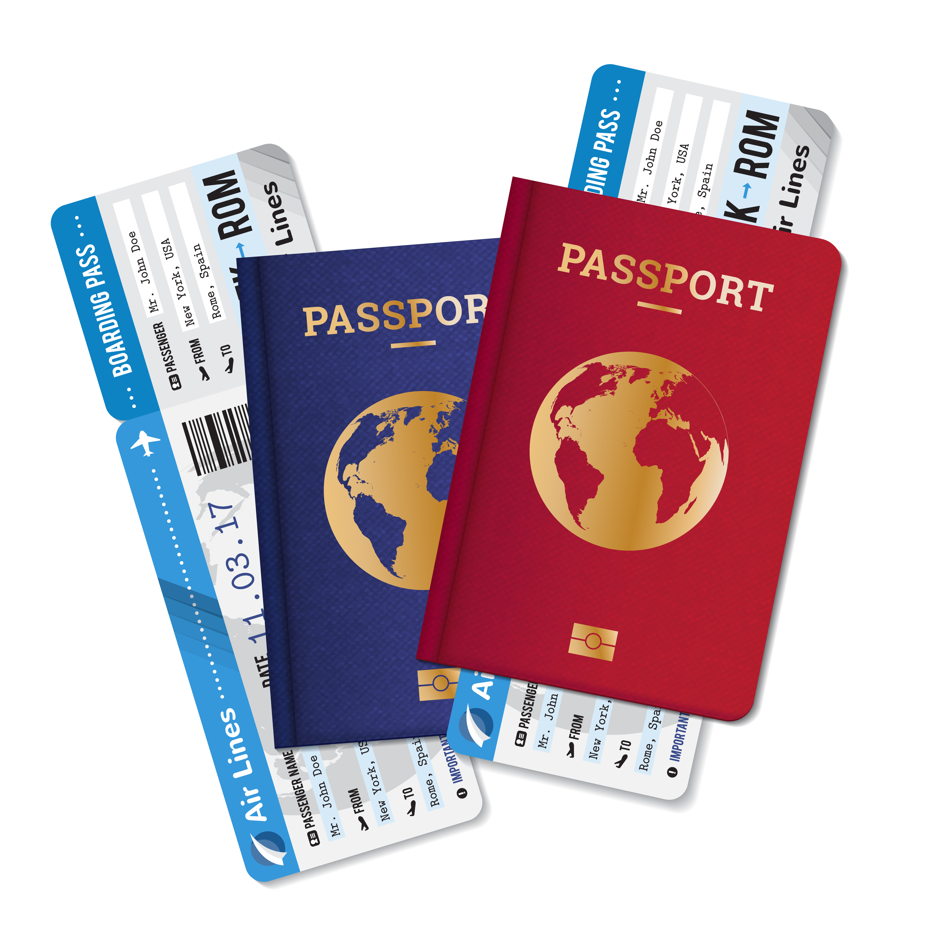
INTRODUCTION
Many passports, identity cards and other identity documents contain a contactless (RFID) chip.
The chip contains reliable personal information about the holder, including the full name, date of birth and nationality, a high-resolution face image, suitable for face recognition.
About
CheckID
Verifying people’s identity is essential in preventing identity fraud and enabling trustworthy digital services. Check ID is the first and leading solution for verifying identity documents using smartphones’ NFC. The combination of identity documents with contactless chips and NFC-capable smartphones is the cornerstone of Check ID

Slide 4
CHECKID FEATURES
Read personal information from the chip
Establish authenticity of identity documents
Access to high resolution face image on chip
Use CheckID Optical Character Recognition to scan QR and interpret the text for processing
Integrate the CheckID SDK’s into your own app through APIs and create a smooth experience
Provide a ready-to-use app called CheckID
Available as SaaS, Client-only
QR and NFC functionality can be licensed separately

Slide 5
CHECKID BENEFITS
Unrivalled reliability of verification
Straight-through processing, with the retrieved data
from the chip available as signed pdf, XML or JSON
without manual backend processes
Data extraction without Optical Character Recognition (OCR) errors or manual typing mistakes
Look-a-like fraud prevention, because of the high-resolution face image that is retrieved from the chip
The chips have protection against cloning, which is based on the highest standards of cryptography

Slide 6
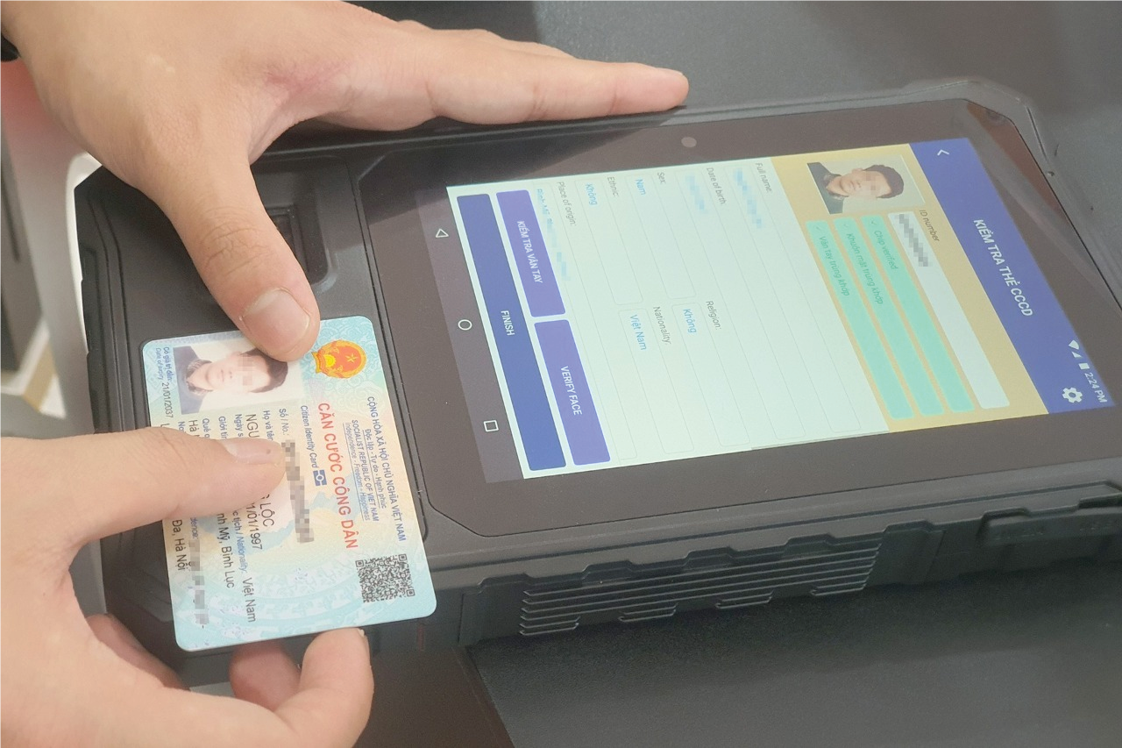
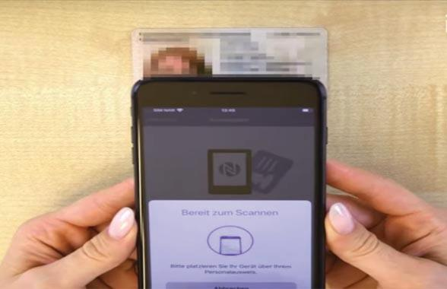
Solution Proposal
1
CheckID solution at Teller Counter
Card Reader required
Auto scan two-side of ID Card
Auto read the information on ID Card via NFC
Auto Liveness checking and Face Matching
Verify the information on chip and surface of ID Card
Check the integrity of data on chip
Check the validity of data on chip with the Government
2
CheckID solution on Mobile Device
Auto capture the MRZ
Auto read the information on ID Card via NFC
Auto Liveness checking and Face Matching
Check the integrity of data on chip
Check the validity of data on chip with the Government

Slide 7
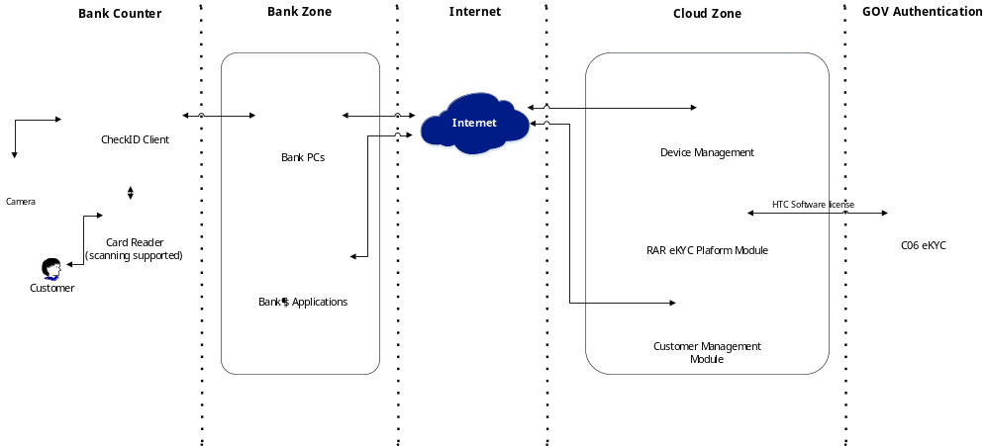
Solution Proposal
1
eKYC solution at Teller Counter

Slide 8
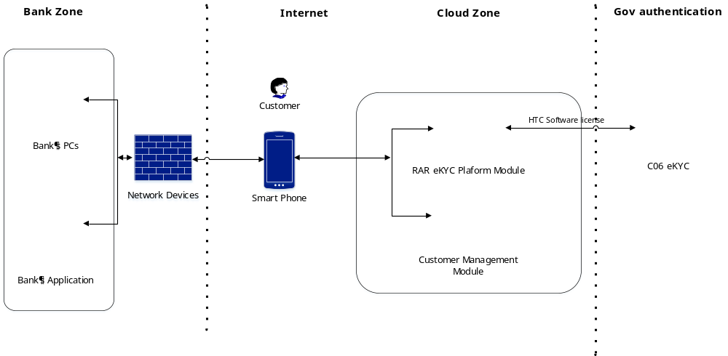
Solution Proposal
1
eKYC solution on Mobile Device

Slide 9
Why CheckID?
Your app, CheckID inside
User Friendly
Face verification
CheckID SaaS is integrated in your app using our CheckID SDK, following your look & feel. It is CheckID inside
It is reliable and user-friendly, much more than optical scanning of identity documents or online video identification
Orchestration with facematch and liveness for holder verification is possible to create the best identy verification solution available
Scalable and secure
Instant results
Privacy committed
Host CheckID SaaS in a highly secure public cloud. Secure and highly scalable
Get the personal information and verification results instantly, via a RESTful
interface (JSON, XML or PDF)
Committed to your security and your customers’ privacy

Slide 10
Demo

Slide 11





Thanks for watching!
MOBILE-ID TECHNOLOGIES & SERVICES JOINT STOCK COMPANY
Level 9, Thuy Loi 4 Building, 286-288 Nguyen Xi street, Ward 13, Binh Thanh District, HCM City
028 3622 2982
info@mobile-id.vn

